Slide 1
Job Market Analysis
Tyler Johnston & Kaelyn Hughes

Slide 2
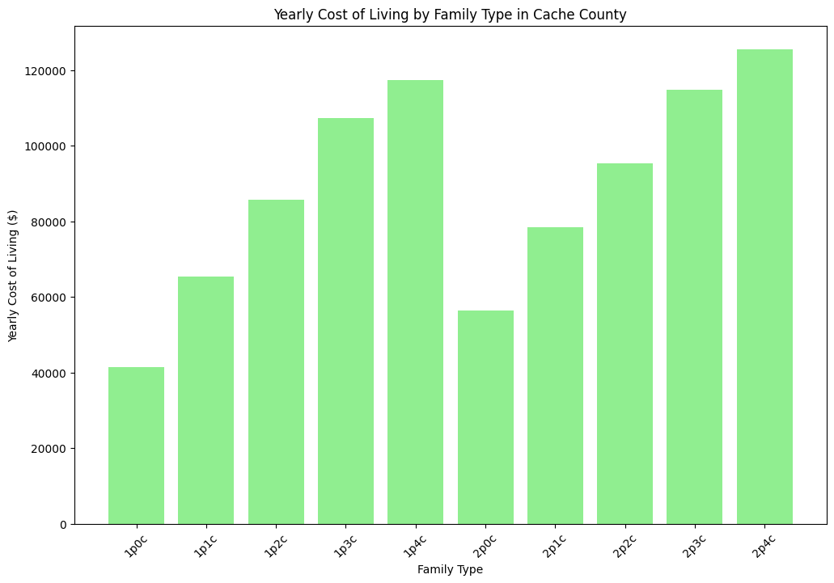
Cost of Living
Top 5 most expensive counties
by monthly cost:
Summit County: $9009.40
Morgan County: $8739.90
Salt Lake County: $8212.30
Washington County: $8098.80
Wasatch County: $8098.70

Slide 3
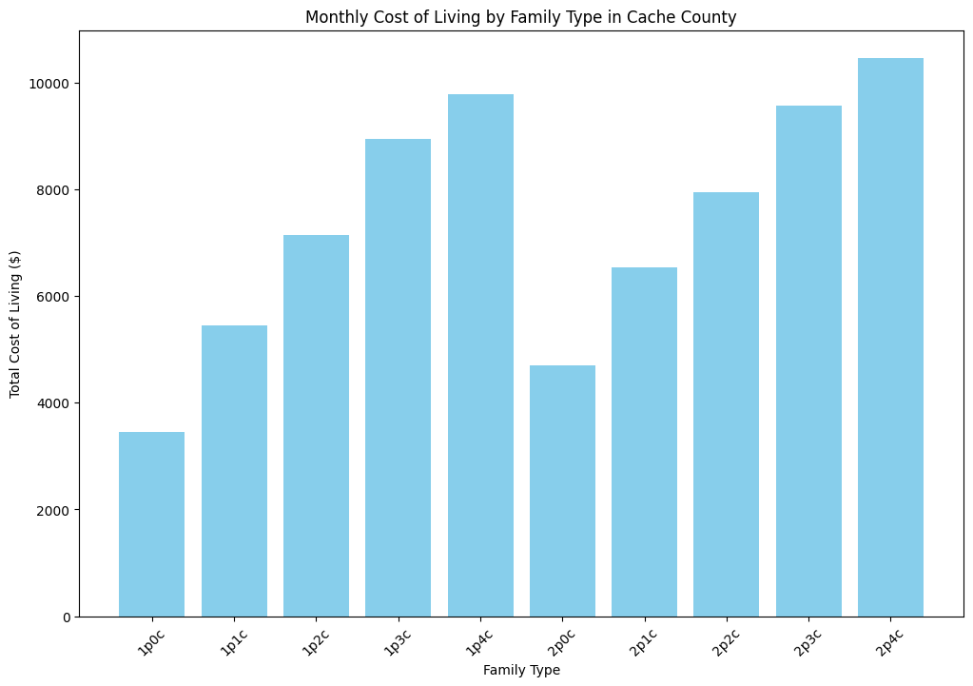
Cost of Living
Top 5 least expensive counties by monthly cost:
Carbon County: $7085.10
Sevier County: $7207.20
Beaver County: $7218.90
Emery County: $7225.80
Duchesne County: $7254.60

Slide 4
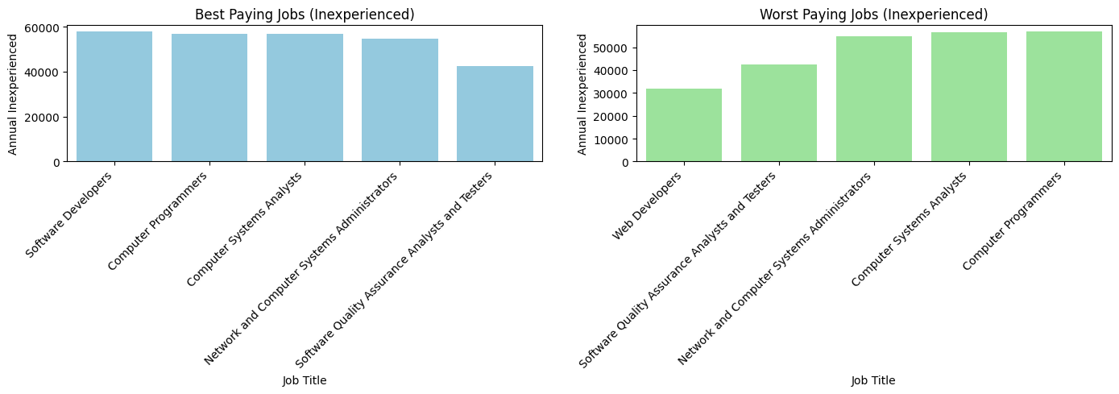
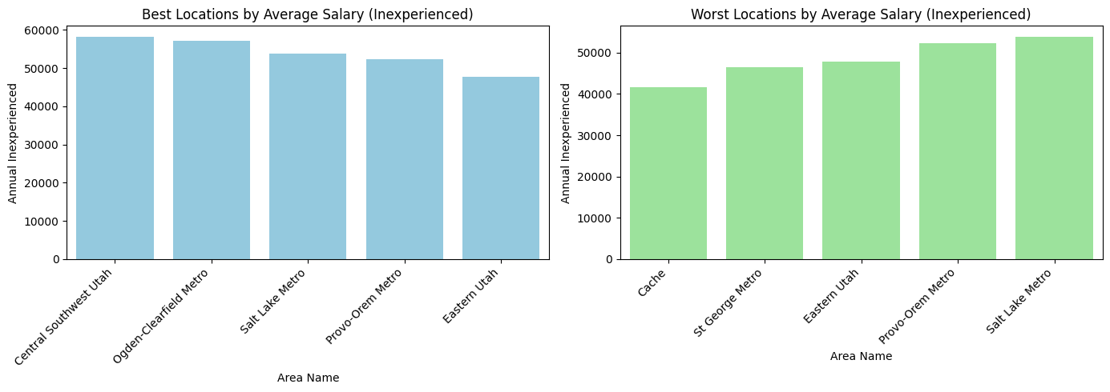
Positions / Locations for $$
- Highest paid: Software Developers & Computer Programmers
- Lowest paid: Web Developers
- Best-paying location - Central/Southwest Utah (Beaver County)
- Close second: Ogden-Clearfield Metro (weber county)
- Cache County - lowest-paying location in Utah

Slide 5
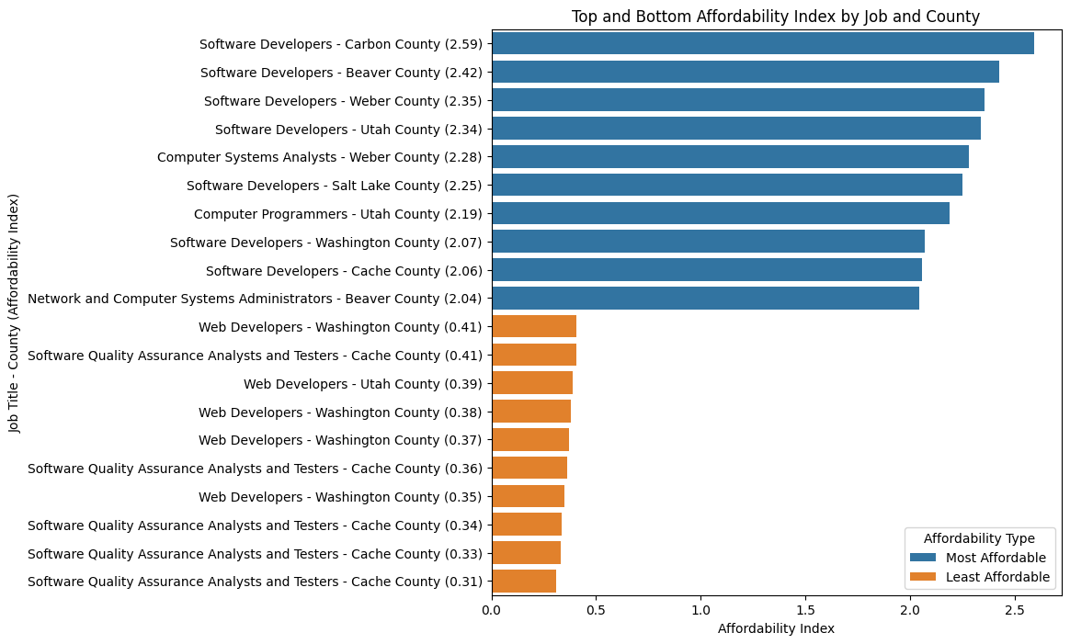
Best Careers & Where to Pursue Them
- Affordability Index = Annual Median Income / Annual Cost of Living per Area
- Highest affordability index: Software Devs in Carbon County
- Lowest affordability index: Web Developers, Testers, & QA - especially in Cache County

Slide 6
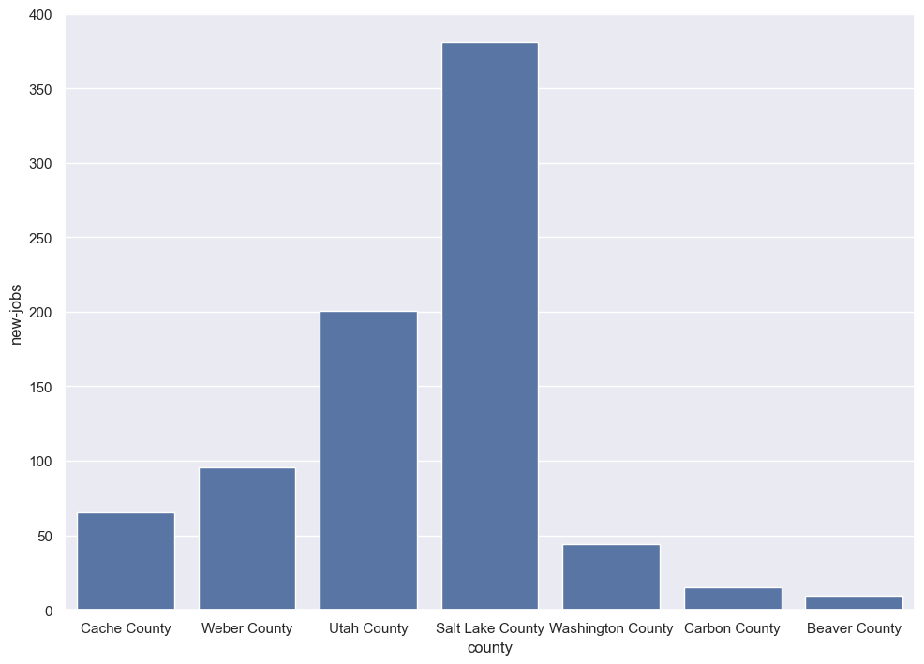
Best Careers & Where to Pursue Them
- New jobs determined by:
- Current number of CS-related jobs in a county
- State of Utah’s projection for CS-related jobs in that county 10 years from now

Slide 7
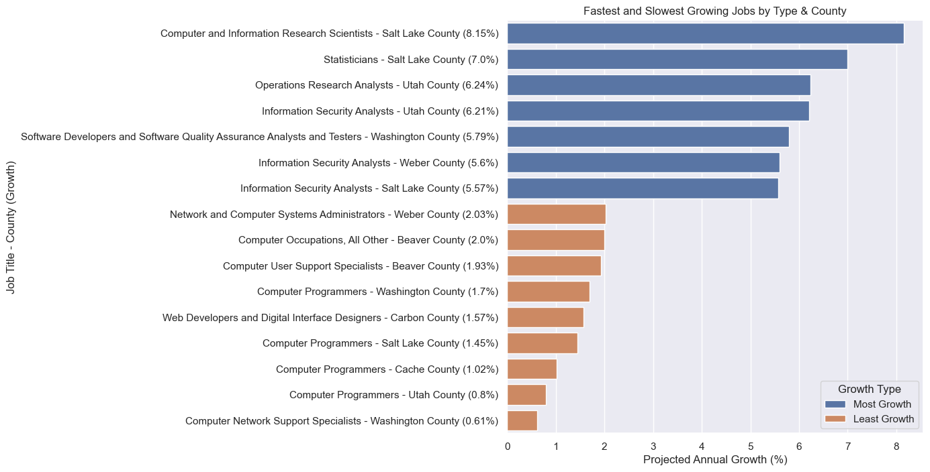
Best Careers & Where to Pursue Them
- Carbon & Beaver Counties might pay well, but they are growing very slowly - might be hard to find a job
- Might have an easier search in Salt Lake or Utah County

Slide 8
T-Tests - Least Significance
Least Significant Comparisons
Computer Systems Analysts vs. Network and Computer Systems Administrators (T-Stat: 0.269, P-Value: 0.788)
Computer Programmers vs. Network and Computer Systems Administrators (T-Stat: 0.699, P-Value: 0.486)
Software Quality Assurance Analysts and Testers vs. Web Developers (T-Stat: 1.125, P-Value: 0.263)
Based on affordability index
Could be telling on most similar jobs, affordability wise

Slide 9
T-Tests - Most Significance
Most Significant Comparisons:
Software Developers vs. Web Developers (T-Stat: 7.095, P-Value: 7.86e-11)
Software Developers vs. Software Quality Assurance Analysts and Testers (T-Stat: 5.603, P-Value: 1.40e-07)
Computer Programmers vs. Web Developers (T-Stat: 4.612, P-Value: 1.02e-05)

Slide 10

Future Plans
More in-depth analysis on what skills you should learn to get the most $
What type of positions are most high in demand
Because we can’t do web scraping, we could implement predictive algorithms to predict one’s salary given cost of living / county info, skills, etc.

Slide 11
Questions?

